Slide 1
Data-based Decision on which condominium to move into

Slide 2
Background
Due rental lease having expired, I am required to find a new place to stay.
Unfamiliar with locations in Singapore, hence I have no idea which neighborhood will be suitable for me.
Utilize a data science approach to identify a neighborhood which is similar to the one I am in now.

Slide 3
Data Acquisition
Data points scraped from website
(https://condo.singaporeexpats.com/property/condo)
Condominium Name
Condominium Address
Data points from Foursquare
Venues surrounding each condominium
Coordinates of venues

Slide 4
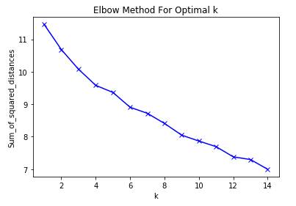
Methodology
k-means cluster analysis would be better suited for a large dataset
Using the elbow method to determine the optimal number of clusters.
Given that the inflexion angle is greatest at k=12, we will proceed with 12 clusters.

Slide 5
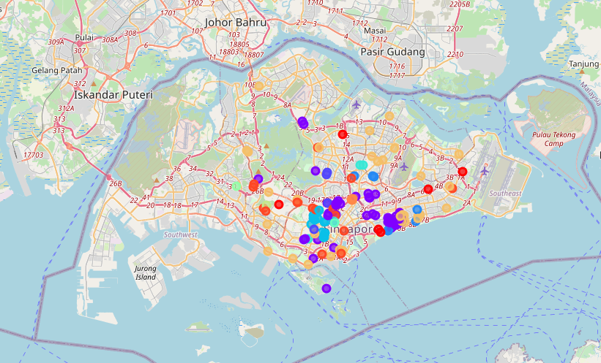
Results
12 clusters were identified.

Slide 6
Conclusion
Cluster 12 was eventually determined to be the most suitable to scout for a condominium as there was a balanced mix of a variety of food and drink venues, as well as shopping options.

